Slide 1


ARTIFICIAL INTELLIGENCE-BASED PLANT CLASSIFICATION SYSTEM
GROUP-19
43324010 Yusmita Pasaribu
43324041 Samuel Manalu
43324056 Christina Simanjuntak

Slide 2
BACKGROUND
A plant species classification system is designed using AI to identify plants from photos. The system integrates a web application, an AI server, an AI model, and a database to generate predictions and automatically store classification history.

Slide 3
PROBLEM FORMULATION
How can a plant species classification system based on Artificial Intelligence be designed and implemented with an AI Server, an Information Server, and a ApplicationWeb, and how high is the model’s accuracy and how does the system perform in terms of response time and data transmission success rate?

Slide 4
OBJECTIVES
To develop and test a plant species classification system based on AI, which includes:
1. An AI Server (VM 2) that receives images, preprocesses them, classifies them.
2. An Information Server (VM 1) that provides physical characteristics, habitat, and care guidance for each plant.
3. An application interface that displays classification results, statistics, and plant information.
4. Testing of model accuracy and system performance (response time and transmission success rate).

Slide 5
TOOLS/ TECHNOLOGY TO BE USED
Software
  Web Application: User interface (login, photo upload, historical log page) and Server 1 acting as the backend.
  AI Server (VM 2): Receives images and performs classification.
  AI Model: Plant type classification using a trained dataset.
  db_ai (database on Server 1): Stores classification history; accessed via SQL queries (SELECT).
  Virtual Machines: Server 1 and Server 2 run independently.

Slide 6
LIMITATIONS
1. Only species included in the dataset can be classified.
2. Input is a static RGB image from a smartphone camera under adequate lighting.
3. Output is limited to the species name and confidence score, with no disease detection.
4. Accuracy depends on the camera, environmental conditions, and dataset quality.
5. The plant-information database is static and only contains species in the dataset.
6. The interface is limited to monitoring and plant information.
7. The network is assumed stable; basic security is limited to Web Admin login and internal access between servers.
8. Testing is done at prototype scale in a controlled environment, without stress testing.

Slide 7
PROBLEM ANALYSIS
1. Users find it hard to identify plant species by direct observation alone.
2. Supporting information such as origin or distribution requires well-stored data sources.
3. A system is needed that classifies plant images and provides additional information that is easily accessible from a smartphone.
Plant classification and plant information need to be built in one integrated architecture.

Slide 8
PROBLEM-SOLVING ANALYSIS
Problem: Manually identifying plant species is difficult and slow, and no identification history is preserved.
Solution : Users upload photos via a web application; the web application sends them to the AI server for classification. The web application then receives the results and stores them in the AI database.
Outcome: Plant identification becomes fast and automated, with a recorded history.

Slide 9
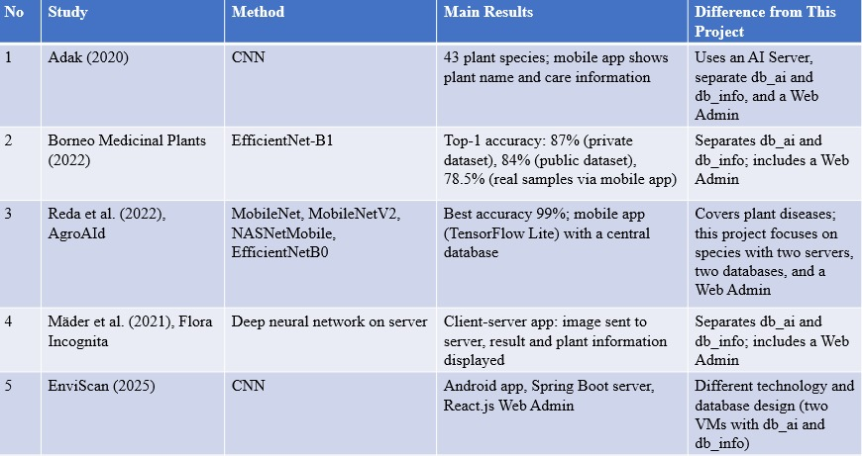
LITERATUR REVIEW

Slide 10
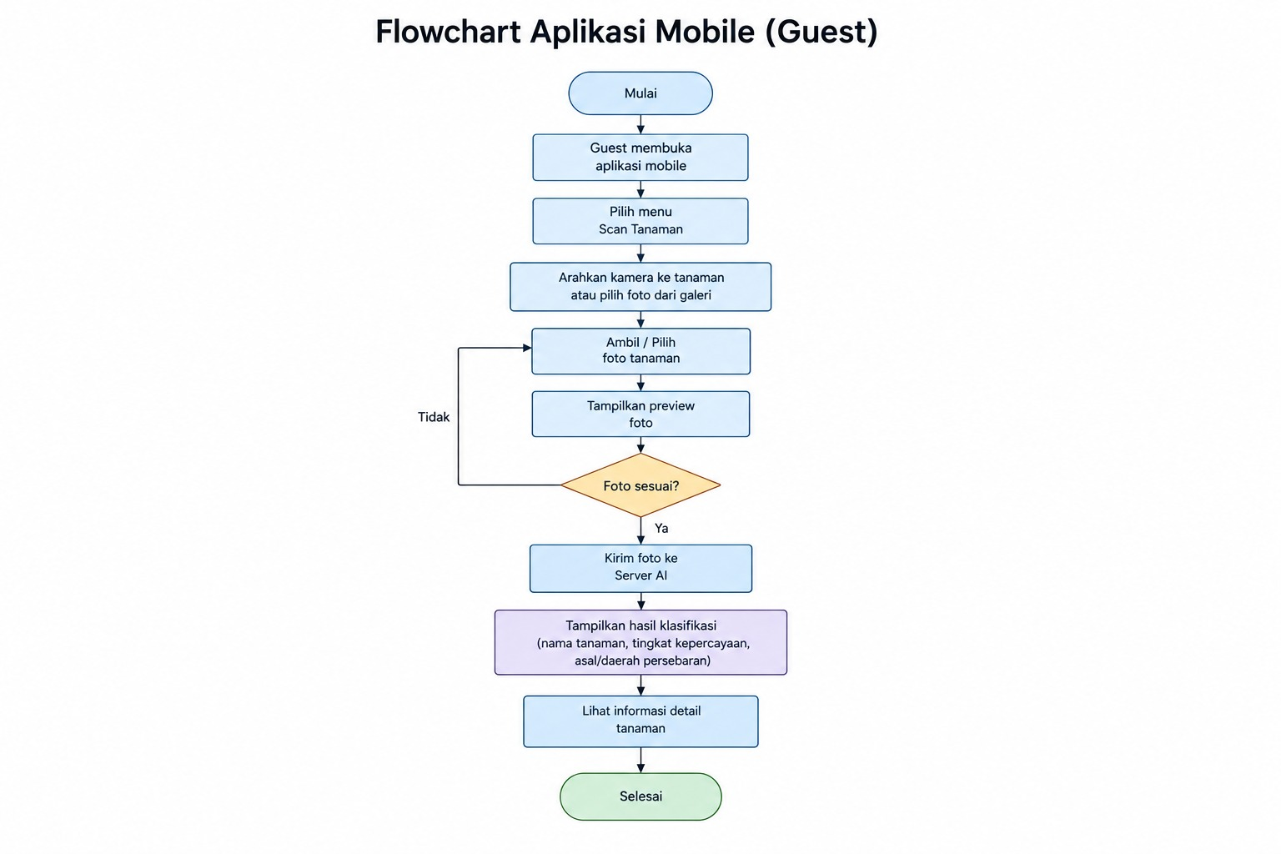
SYSTEM FLOWCHART
  Selecting a Photo: The guest takes a photo of the plant using the camera or selects one from the gallery.
  Checking the Photo: The system displays a preview to ensure the photo is suitable.
  Plant Classification: The photo is sent to the AI ​​server for processing.
  Displaying Results: The app displays the plant name, confidence level, and distribution area.
  Viewing Information: The guest can view detailed information about the plant.

Slide 11
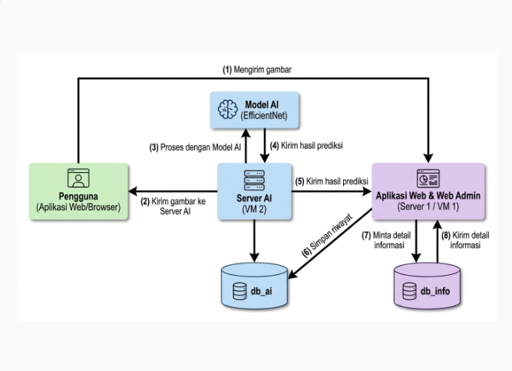
SYSTEM ARCHITECTURE
Stateless AI Processing
Web application forwards user images to VM 2 strictly for EfficientNet classification.
Centralized Data Logic
Web Server (VM 1) handles prediction results, fetches plant data, and logs history.
Integrated Management
Web Admin interface provides unified access to logs and botanical information.

